Slide 1
PREETI RAJENDRA JAWALKAR Computer vision and IoT Internship task-2 Prediction using Unsupervised ML GRIP @ The Sparks Foundation

Slide 2
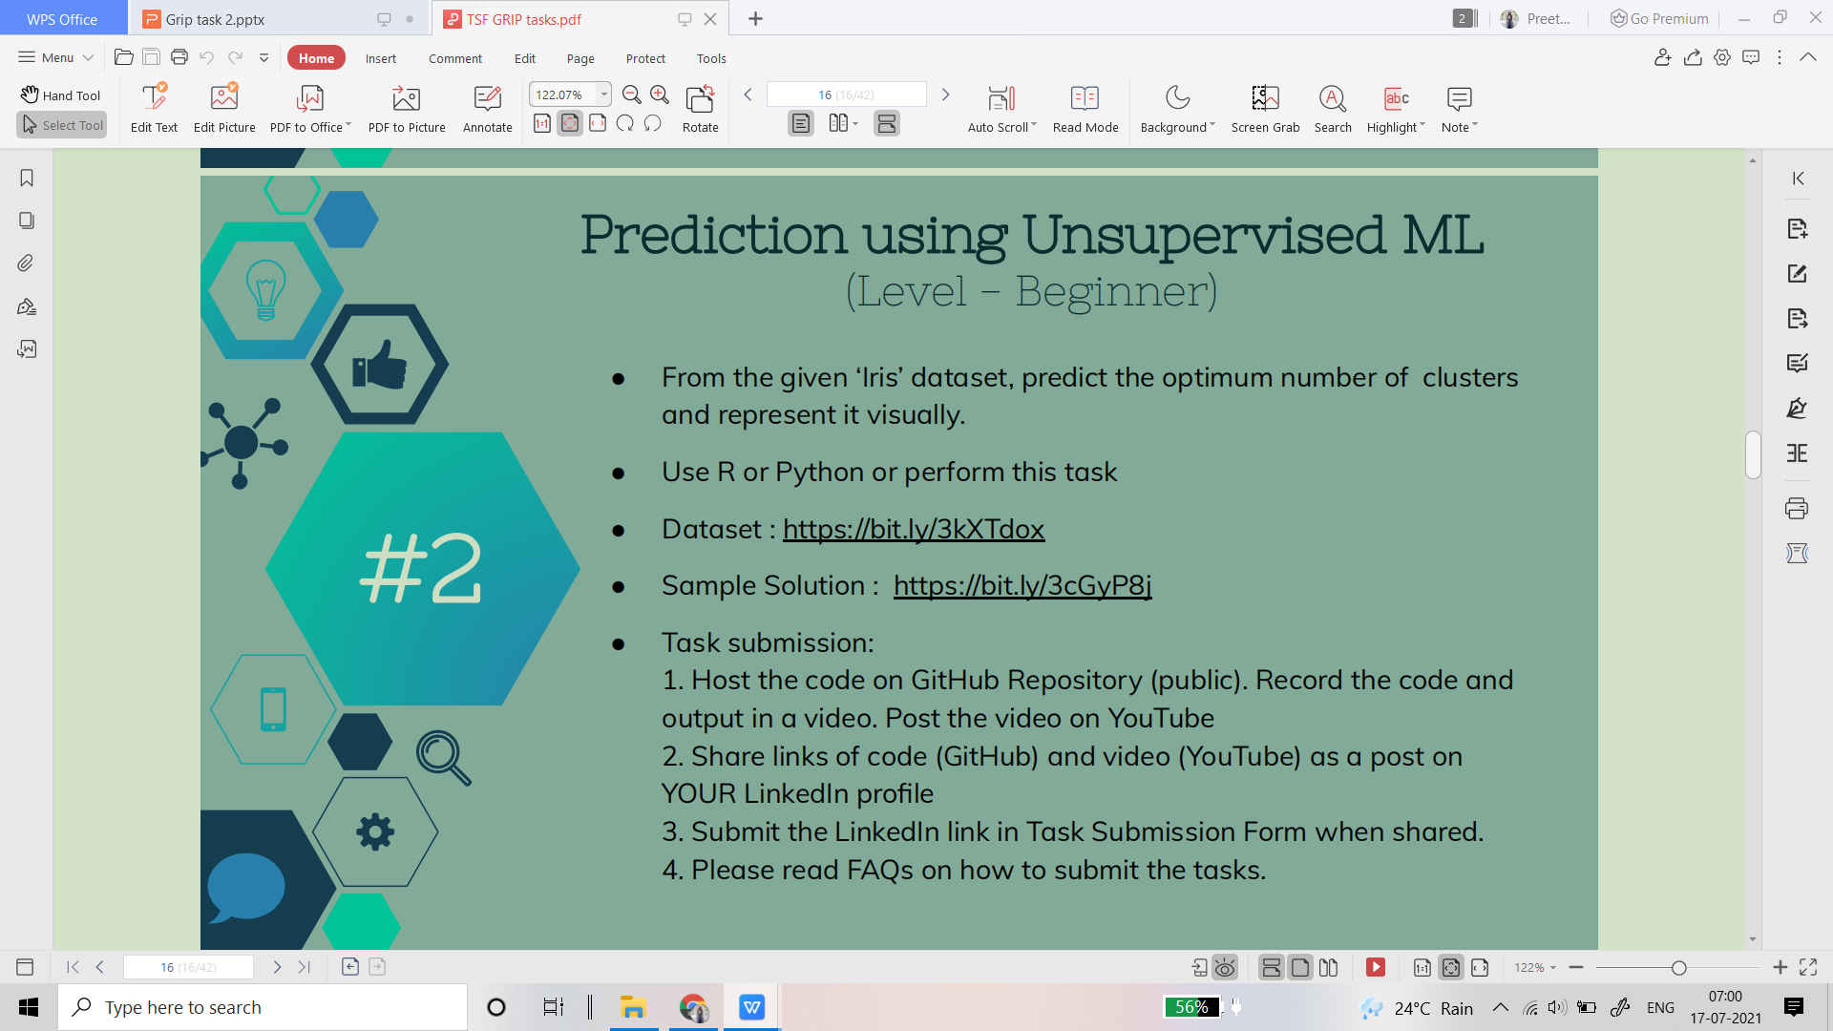
TASK-2

